Slide 1

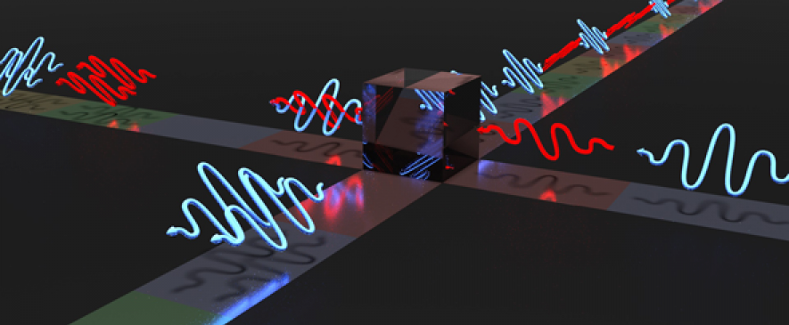
Quantum Cryptography
Cryptography is the process of encrypting and protecting data so that only the person who has the right secret key can decrypt it. Quantum cryptography is different from traditional cryptographic systems in that it relies on physics, rather than mathematics, as the key aspect of its security model.
Quantum cryptography is a method of encryption that uses the naturally occurring properties of quantum mechanics to secure and transmit data in a way that cannot be hacked.

Slide 2
History
FROM THE BEGINNING : -
At the early stage of Quantum Cryptography , when quantum signal was used to encode the transmitter’s confidential message in such a way that the receiver could decode it, if there is no eavesdropper. But in the presence of an eavesdropper, if the eavesdropper attempted to intercept the messages , then the message was spoiled and no information was leaked.
DISADVANTAGE :
( i ) At the early stage of Quantum Cryptography it may look like that it is safe , but in reality there are many disadvantages like delay of time increases . If the message was spoiled then the sender have to send the message again and that may take a long time.
( ii ) The process was unidirectional and it required legitimate parties to share a secret key, much as in a one time pad encryption.
( iii ) The One time pad encryption can be used over and over again if no eavesdropping are detected but if eavesdropping are detected then it will be no longer used for.

Slide 3

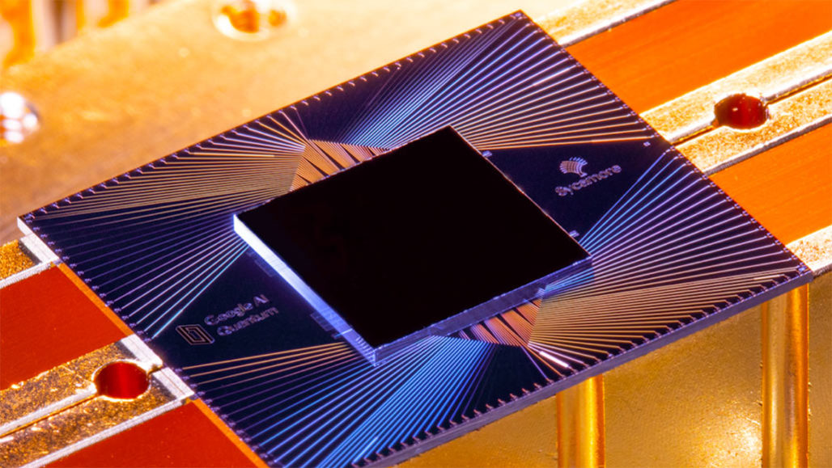
To avoid the disadvantages , another theory was arrived. It would be easier to use the quantum channel to transmit an arbitrarily long random secret key. If eavesdropping were detected on the quantum channel, due to unavoidable disturbance, the key would be thrown away ; otherwise it could be used safely to transmit a sensitive message by use of the classical one-time pad scheme. (BB84 PROTOCOL)
DISADVANTAGES : -
( i ) Quantum channels are susceptible to various types of noise and errors. Quantum states can be lost or corrupted during transmission.
( ii ) Quantum channel has finite range due to phenomena like quantum decoherence and absorption. If the distance between sender and receiver increases , the probability of successfully transmitting quantum states decreases.
( iii ) The rate at which secure bits can be generated over a Quantum channel is limited.

Slide 4

The previous two theory was rejected because of their major disadvantages . But in the early time of 1990’s , Quantum key was discovered . After that , some theory was revealed and became more feasible because entanglement-based cryptography provided a form of Quantum Key Distribution that would remain secure not only against eavesdropping , but also against burglary.
SECRET KEY : - In classical cryptography a secret key is a random string of bits used to encrypt and decrypt messages using classical encryption algorithms.
QUANTUM KEY : - In quantum cryptography a quantum key is a sequence of quantum states (usually photons) prepared in specific quantum states, like polarized photons or qubits.

Slide 5
Evolution of Quantum Computing :
Before we proceed towards deep in Quantum Cryptography , we have to know about Quantum Computing a little bit. Quantum Computing is at the initial stage of technology evolution but has a high potential of generating innovations in quantum communications, quantum cryptography, quantum optics etc. to support competitive advantage of firms and nations. As we all know that the evolution of technologies is driven by science, increases based on the interaction between technologies and scientific fields that generate co-evolutionary pathways of new technological trajectories.

Slide 6
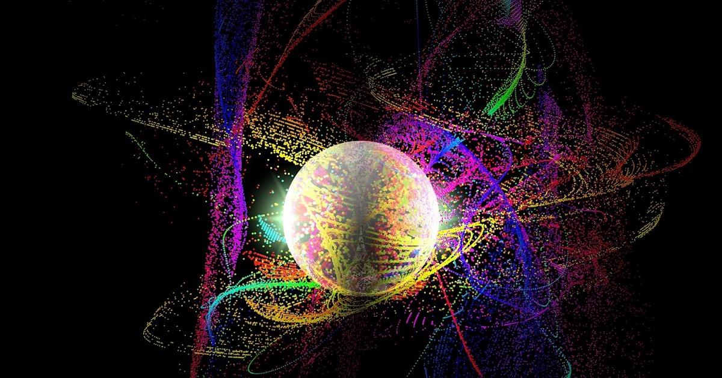
Theoretical Framework
The theoretical framework of quantum computing is based on principles from quantum mechanics and information theory. There are some key elements which are mentioned by the scientists and developers to understand Quantum Computing.
Quantum Bits (Qubits): Quantum bits, or qubits, are the fundamental units of quantum information. Unlike classical bits, which can represent either a 0 or a 1, qubits can exist in a superposition of states. This means that a qubit can represent both 0 and 1 simultaneously, with varying probabilities. Superposition is a crucial property that enables quantum computers to perform certain computations much faster than classical computers.
Entanglement: Entanglement is another unique property of quantum systems. When two qubits become entangled, the state of one qubit becomes dependent on the state of the other, regardless of the distance between them. This phenomenon allows for the creation of quantum gates that can perform operations on multiple qubits simultaneously, leading to the potential for massively parallel computation.

Slide 7

Quantum Gates: Quantum gates are the quantum analogs of classical logic gates. They are used to manipulate qubits, change their states, and perform computations. Common quantum gates include the Hadamard gate, CNOT gate (controlled-NOT), and Toffoli gate, among others. These gates are responsible for creating quantum circuits to execute quantum algorithms.
Quantum Algorithms: Quantum computing is best known for its potential to solve certain problems exponentially faster than classical computers. Shor's algorithm, for example, can factor large numbers efficiently, threatening current encryption methods, while Grover's algorithm can perform database search tasks faster. Other algorithms, like those for quantum simulations and optimization, also show promise in various fields.
Quantum Superposition: Superposition allows qubits to be in multiple states at the same time. This property is exploited in quantum algorithms to explore multiple possibilities simultaneously. Quantum algorithms often use superposition to speed up certain types of calculations, like factoring large numbers or searching unsorted databases.
Quantum Measurement: Measurement in quantum computing collapses the superposition of qubit states into a definite classical state. The outcome of a measurement is probabilistic, and the probability of a specific measurement result is determined by the coefficients in the superposition.

Slide 8


MATERIAL AND METHOD
Step 1
Step 2
Step 3
DATA COLLECTION
DATA PROCESSING
DATA EXPLORATION
DATABASE : Web of Science core collection
SEARCH STRING :
TS = ( “QUANTUM COMPUT” ) Refined by : Document Types : Article; Language; English;
WEB OF SCIENCE INDEX : SCI – EXPANDED;
PUBLICATION YEARS : 1990 – 2020;
RESULTS : 14132 articles;
UNIT OF ANALYSIS : DE tag (Original Keywords)
DATA CLEANING :
(i) Removing Keywords not include “Quantum”
(ii) Merging Keywords with the same meaning ( E.g. Quantum Computation and Quantum Computing
(iii) Word Standardization : Combining Keywords with same structure ( E.g. Quantum Bits and Qubit).
NETWORK BUILDINGS :
(i) Splitting sample into three periods ( 1990 – 2000, 2001 – 2010 , 2011 – 2020)
(ii) Building networks of Keywords using Sci2 tool V.1.3
NETWORK VISUALIZATION using Gephi software V.3.6.5
NETWORK ANALYSIS USING SCI2 TOOL :
(i) Calculating Degree Centrality, Betweenness Centrality, Closeness Centrality
(ii) Identifying the emerging technologies over time.

Slide 9

DATA COLLECTION AND SAMPLE :
We used the Web Of Science – WOS core collection database for extracting the articles related to QC. The sample contains 14132 articles
split into three timespan periods :1990 – 2000; 2001 – 2010; 2011 – 2020.
B. DATA PROCESSING AND ANALYSIS :
First, we used originals keywords of articles (DEs) tag as the basis for the detection of technologies related to QC. Second , we have done the cleaning of data for constructing the network. We kept only the key phrases combined with the word “Quantum”.
C. CREATION AND EXPLORATION OF NETWORKS :
Finally, we generated co-occurrences networks by SCI2 Tool V.1.3 software and imported them as a GraphMl format file into Gephi software version 3.6.5 to visualize and analyse the networks for each period under study.

Slide 10

TABLE 1
COMPARISON OF NETWORK MEASURES AND INDICATORS OVER THREE PERIODS
 |  |  | Growth from |  | Growth from
 | ( 1990 – 2000 ) | ( 2001 – 2010 ) | ( 1990 – 2000 ) | ( 2011 – 2020 ) | ( 2001 – 2010 )
 |  |  | To ( 2001 – 2010 ) |  | To ( 2011 – 2020 )
Total No of Articles | 668 | 5224 | 6.82 | 9189 | 0.76
No of Nodes | 87 | 477 | 4.48 | 1054 | 1.21
No of Links or Edges | 140 | 793 | 4.66 | 2244 | 1.83
Graph Density | 0.037 | 0.007 | -0.81 | 0.004 | -0.43
Avg. Path Length | 2.332 | 2.748 | 0.18 | 2.859 | 0.04

Slide 11

RESULTS :
Nodes represent vertices in a graph.
Links (or edges) are connections between nodes (or vertices) of the network.
Graph density is the maximum number of existed edges divided by the number of edges.
Avg. path length is the number of steps in average, through the shortest routes between all joints of network nodes.
Table 1 shows the interconnection of QC-related words.
Interconnection of QC- related words in 1990 – 2000 :
(i) There are 87 nodes and 140 edges.
(ii) There are 668 articles, Graph Density is 0.037
(iii) Quantum logic and Quantum communication showed significant connections with QC nodes.

Slide 12

B. Quantum Network Expansion in 2001 – 2010 :
(i) Quantum dot plays a significant bridging role in the
Network. There is a strong linkage between Quantum Gate, Quantum
Dot, Quantum Info and Quantum Computer.
(ii) There are 477 nodes and 793 edges.
(iii) There are 5224 articles; Graph Density is 0.007
C. Evolution of Quantum Network in 2011 – 2020 :
(i) Quantum algorithm experiences considerable growth in
DC measures.
(ii) There are 1054 nodes and 2244 edges.
(iii) There are 9189 articles; Graph Density is 0.004
Here you can see the graph of the three time period . The graph is based on the number of articles along y axis and the time period along x axis.

Slide 13
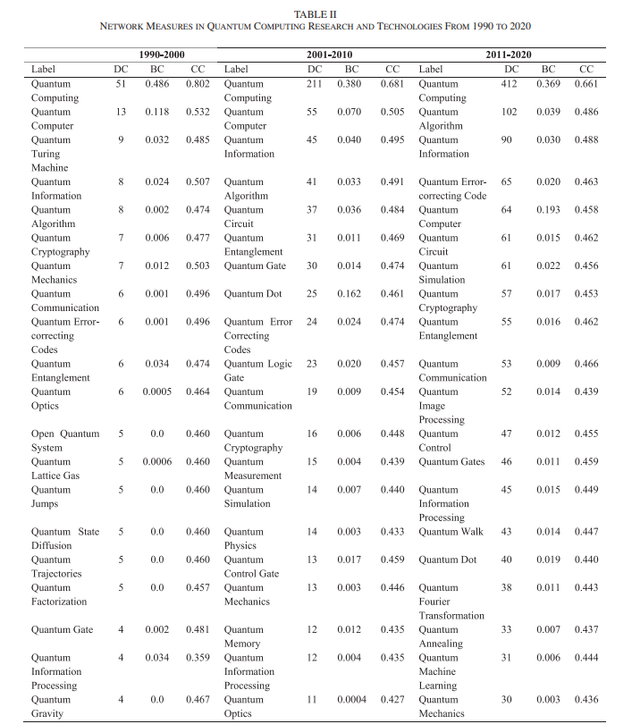
RESULT ANALYSIS
DC – DEGREE CENTRALITY :
Indicates number of connections (connectivity) in the network of keywords.
BC – BETWEENNESS CENTRALITY :
Indicates the amount of influence or control a node has over the flow between nodes and networks. (similar to bridge).
CC – CLOSENESS CENTRALITY :
Indicates the easiest access to all other nodes in a network or sub-network (shortest distance from nodes).

Slide 14


Evolution of Network in QC Research from 1990 to 2000 :
* In the first period, Table II show that quantum computer and quantum Turing machines have the highest DC. QC (item) with the BC of 0.486 and quantum computer with 0.118 established essential bridges among other network nodes to facilitate the interaction and coevolution between different topics.
* In this network, quantum optics, quantum searching, quantum lattice gas, quantum quantitates, quantum logic, and quantum communication also illustrate a significant connection with QC node.
B. Evolution of Network in QC Research from 2001 to 2010 :
* In the 2001–2010 period, the Quantum network has a great expansion. Table II shows that Quantum information and Quantum algorithms grasped the highest level of DC after QC and Quantum computer. Quantum dot with a value of 0.162 had a significant role in bridging the network.
* Quantum gate and Quantum dot have created new strong linkages with the node of Quantum computer, creating potential characteristics of coevolution over the course of time.

Slide 15

C. Evolution of Network in QC Research from 2011 to 2020 :
* In the period from 2011 to 2020, Table II show that Quantum algorithm has been experiencing a considerable growth in the DC measure. In this period, it has expanded even more than Quantum computer and can be considered the second highest DC node in the interconnection network of QC.
* Quantum information and Quantum correcting-error code have a higher DC value than Quantum computer: this result shows the growing importance of software development in QC. In fact, these results also illustrate a transition of QC research from hardware to software aspects in evolutionary development.
D. General Evolution of the Network in QC Research and Emerging Technologies for Innovative Applications in Markets :
* An in-depth technology analysis within the network of QC shows that in the period 1990 - 2000, the highest connectivity is due to nodes of Quantum Turing machine (DC = 9) and quantum information (DC = 8), in addition, of course to main nodes of QC and quantum computer. In 2001–2010 period, the highest connectivity is driven by quantum information with a considerably increase of DC=45 and quantum algorithm having DC = 41. In the last period (2011–2020), the acceleration of connectivity is driven due to quantum algorithm (DC = 102), quantum information with DC = 90, and the new entry of quantum error-correcting code (DC = 65). These evolutionary aspects of QC research suggest, as said, a transition from hardware to software characteristics of the science dynamics.

Slide 16

TABLE III
PATTERN OF THE EVOLUTION OF QUANTUM COMPUTING RESEARCH FROM 1990 – 2020 , BASED ON TOP 20 FIELDS OF TABLE II
PERIOD | DEGREE CENTRALITY ( DC ) | BETWEENNESS CENTRALITY ( BC ) | CLOSENESS CENTRALITY ( CC )
1990 - 2000 | 8.45 | 0.038 | 0.496
2001 - 2010 | 33.05 | 0.043 | 0.470
2011 - 2020 | 71.25 | 0.042 | 0.465
% growth of 2001 – 2010 on 1990 – 2000 period | 2.91 | 0.14 | -0.05
% growth of 2011 – 2020 on 1990 – 2000 period | 7.43 | 0.12 | -0.06
% growth of 2011 – 2020 on 2001 – 2010 period | 1.16 | -0.016 | -0.011

Slide 17


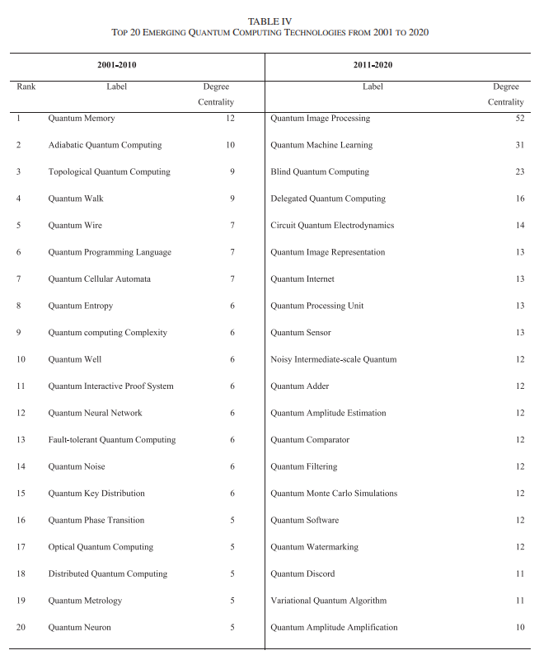
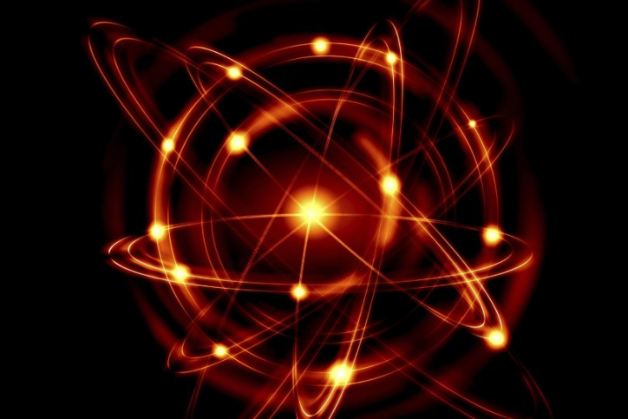
TABLE IV ANALYSIS

Slide 18

Disadvantage :
The precision of the search queries is affected by ambivalent meanings in QC, such as information, computing, computer, etc.
QC research changes its borders during the evolution of science, and as a consequence, the morphology of network during the evolution, generating an irregular and complex shape, such that the identification of stable technological trajectories and scientific fields over the course of time is a difficult exercise.
QC calculations are dependent on the values of degree centrality, betweenness centrality ,closeness centrality. The calculations of these values requires specific hardware which is costly and limited resource.
QC research that are increasingly based on growing connectivity between technologies and research fields, but a further detailed examination is needed for explaining the driving factors of the technological evolution and supporting an appropriate strategic management of innovation that supports a new quantum industry for the competitive advantage of firms and nations for policymakers and funding agencies can use these funds here for developing quantum computing research field.

Slide 19

Conclusion
The Evolution of QC Research shows that from 2001-2020 the no. of nodes has a continuous growth increasing the connectivity between nodes and increasing nodes that control the flow between nodes it also shows that new research fields and technologies emerge such as Quantum image processing, Quantum machine learning etc.

Slide 20


Low – Cost Shuffling Countermeasures Against Side Channel Attacks for NTT Based Post Quantum Cryptography :

Slide 21
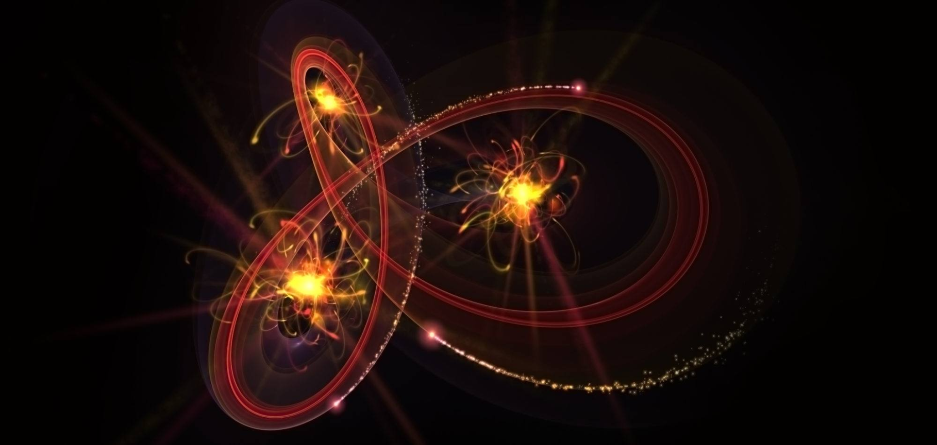
The Quantum Computing technology has brought great threats to the security of widely used RSA and elliptic curve cryptography . To develop next-generation standards, the National Institute of Standards and Technology (NIST) called for quantum-resistant public-key cryptography algorithms in 2016 . In the collected algorithm categories, lattice-based cryptography (LBC) has advantages in speed and key size (Number of bits in a key used by a cryptographic algorithm) .
Lattice – Based Cryptography :
Lattice-based cryptography is the generic term for constructions of cryptographic primitives that involve lattices, either in the construction itself or in the security proof. Lattice-based constructions are currently important candidates for post-quantum cryptography. Unlike more widely used and known public-key schemes such as the RSA, Diffie-Hellman or elliptic-curve cryptosystems — which could, theoretically, be defeated using Shor's algorithm on a quantum computer — some lattice-based constructions are considered to be secure under the assumption that certain well-studied computational lattice problems cannot be solved efficiently.

Slide 22

There are many building blocks in Lattice – Based Cryptography (LBC) . For example , Number Theoretic Transform, Schoolbook – Style Polynomial Multiplier , Fujisaki – Okamoto(FO) Transformation etc. are vulnerable in practice . Among the building blocks , NTT is a fundamental and universal module . Number theoretic transform (NTT) is the most efficient method for multiplying two polynomials of high degree with integer coefficients, due to its series of advantages in terms of algorithm and implementation, and is consequently widely-used and particularly fundamental in the practical implementations of Lattice - Based Cryptographic schemes.
Number Theoretic Transform
Forward NTT Inverse NTT
The forward NTT transforms a polynomial from the time domain to the frequency domain.
Given a polynomial A(x) of degree n -1, the forward NTT computes a transformed polynomial A^(x) such that A^(x)=A(ωx) mod q, where ω is a primitive n-th root of unity and q is a modulus.
The inverse NTT, as the name suggests, performs the inverse operation. It transforms a polynomial from the frequency domain back to the time domain.
Given a transformed polynomial A^(x), the inverse NTT computes the original polynomial A(x) such that A(x)=A^(x/ω) mod q.

Slide 23

Disadvantage of using NTT :
In the early stage , there is a big problem in NTT . It uses secret key as the input data of NTT – related operations . Thus the operations are ideal and threatening targets of side channel attacks (SACs) . Primas and others proposed a series of template attacks (TAs), which use the power templates of modular multiplication and regular factor graph of forward NTT (FNTT) or inverse NTT (INTT) process. These attacks can be used to break many common cryptographic algorithms, such as RSA, DSA, and ECDSA.
The TAs work by first constructing a template for the power templates of modular multiplication. This template is then used to construct a factor graph for the FNTT or INTT process. The factor graph is then used to construct a series of attacks against the cryptographic algorithm .The TAs are new and powerful technique for breaking cryptographic algorithms. They are likely to have a significant impact on the security of many common cryptographic algorithms.
Solution :
There is a way to prevent the SCA . A well – studied SCA countermeasures is to decouple the signal strength from the secret value by Masking it with a random value.
Masking refers to a technique used to enhance the security of cryptographic primitives by introducing randomization or noise into the computation. The basic idea is to add a random "mask" to the input data before performing cryptographic operations, making it more difficult for an attacker to extract sensitive information.

Slide 24

Disadvantage of Masking :
Although Masking is a solution of previous disadvantage but it has it’s own disadvantage . Masking leads to 5.7 x clock cycles on software and fails to resist TAs or higher order attacks .
Solution :
To prevent the TAs or higher order attacks a time based countermeasures category called shuffling had been arrived . Shuffling can prevent TAs and higher order attacks by disrupting the power templates and factor graphs. When the inputs to the cryptographic algorithm are shuffled, the power templates and factor graphs are no longer regular, and the attacks are no longer effective.
There are two main ways to shuffle the inputs to a cryptographic algorithm:
Input shuffling : This is the simplest way to shuffle the inputs. The inputs are simply shuffled before they are used in the cryptographic algorithm.
Output shuffling : This is a more complex way to shuffle the inputs. The outputs of the cryptographic algorithm are shuffled before they are used. This can be more effective than input shuffling, because it can also prevent attacks on the cryptographic algorithm itself.

Slide 25

Polynomial Ring :
Before we proceed towards the algorithms , at first we have to know about Polynomial Rings.
In cryptography, a polynomial ring refers to a specific type of algebraic structure used for representing and manipulating polynomials. It is formed by a set of polynomials with coefficients coming from a certain field (designated as F) and with basic operations like addition and multiplication defined for them .
Polynomial ring is a mathematical structure represented as Rq = Zq[x]/(x^n + 1), in which n satisfies power of two and q is a prime .
Rq: This denotes a polynomial ring named Rq. The subscript q indicates that the coefficients of the polynomials in this ring belong to the finite field Zq, where q is a prime number.
Zq[x]: This represents the polynomial ring of polynomials in one indeterminate (x) with coefficients from the field Zq. The indeterminate x represents an unknown variable that can take on values from Zq.
(x^n + 1): This part of the notation indicates that we are taking the quotient of the polynomial ring Zq[x] by the ideal generated by the polynomial x^n + 1. An ideal is a subset of polynomials in a ring that satisfies certain closure properties. In this case, the ideal generated by x^n + 1 consists of all polynomials that can be expressed as a multiple of x^n + 1.

Slide 26

SHUFFLING COUNTERMEASURES :
As you know that shuffling is basically used to prevent the template attacks, this section prevents the adversary from recovering the secret key by reordering the basic arithmetic operations. We propose coefficient index randomization (CIR) and NTT network randomization (NNR) against SCAs targeting point-wise operations and NTT .
CIR :
Coefficient index randomization (CIR) is a technique used in cryptography to protect against frequency analysis attacks. Frequency analysis is a technique used to break ciphers by analysing the frequency of different symbols in the cipher text. CIR works by randomly changing the frequency of symbols in the cipher text, making it more difficult to analyse. The CIR divides a n-round operation into n/2 couples and provides 2n/2+log(n/2) permutations. The bits rn[7:1] select the first couple to be fetched and the internal order of a couple is controlled by random bit stream from rn[0].
NNR:
NTT network randomization is a technique used in post-quantum cryptography to protect against side-channel attacks. NTT network randomization works by randomly reordering the operations in a cryptographic algorithm. This randomization makes it more difficult for an attacker to observe the physical behaviour of the algorithm and extract information about the secret key.
NTT network randomization is typically implemented by using a random number generator to generate a permutation of the operations in the cryptographic algorithm. This permutation is then applied to the algorithm, and the resulting algorithm is executed. The randomized algorithm will have a different physical behaviour than the original algorithm, making it more difficult for an attacker to observe and exploit.

Slide 27
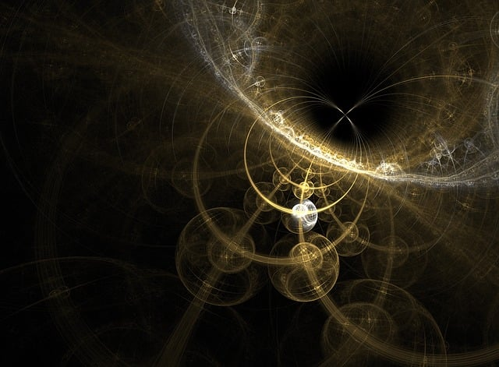
DISADVANTAGE OF CIR AND NNR :
DISADVANTAGES OF CIR :
(i) CIR can add some overhead to the encryption and decryption process, as it requires the generation and application of random coefficients. This can make CIR-based algorithms less efficient than their non-randomized counterparts.
(ii) If an attacker can recover the randomization coefficients, they may be able to reverse the randomization and recover the original plaintext. This could be a concern if the coefficients are not sufficiently random or if they are reused over multiple messages.
DISADVANTAGES OF NNR :
(i) NNR can make cryptographic hardware more complex, as it requires additional logic to handle the randomized ordering of operations. This can increase the cost and power consumption of NNR-based implementations.
(ii) If the randomized ordering of operations is not carefully designed, it could introduce new timing variations that could be exploited by timing side-channel attacks. This could be a concern if the algorithm is used in a setting where timing leaks are a risk.

Slide 28

DISADVANTAGE OF USING SHUFFLING :
(i) Shuffling methods can add some overhead to the encryption and decryption process, as they require the rearrangement of data elements. This can make shuffling-based algorithms less efficient than their non-shuffled counterparts.
(ii) Shuffling algorithms can sometimes introduce bias into the cipher text, which can be exploited by attackers to break the cipher. This is particularly true for shuffling algorithms that are not carefully designed.
(iii) Shuffling algorithms can sometimes result in non-uniform distributions of data elements in the cipher text. This can also be exploited by attackers to break the cipher.
(iv) Shuffling algorithms can sometimes consume a significant amount of memory, as they require the storage of shuffled data elements. This can be a concern for applications that are constrained by memory availability.
Despite these disadvantages, shuffling methods can still be a valuable tool in cryptography. They can be used to improve the security of algorithms against certain types of attacks, such as frequency analysis attacks and pattern recognition attacks. However, it is important to carefully consider the potential drawbacks of shuffling methods before using them in a cryptographic application.

Slide 29

Side – Channel Analysis of Post – Quantum Cryptographic Algorithms :

Slide 30

As we discuss before that Quantum Computing technology has brought great threats to the security of widely used RSA and elliptic curve cryptography , Post Quantum Cryptographic Algorithm gives us some relief from that great threat. To address the need for long-term security, in 2016 NIST started a project for standardizing post-quantum cryptography (PQC) primitives that rely on problems not known to be targets for a quantum computer, such as lattice problems.
Here we are going to discuss about the two NIST PQC candidates, Saber and CRYSTALS-Kyber Key Encapsulation Mechanisms (KEMs), to side-channel attacks. Here we are going to represent about the side-channel analysis of Saber and CRYSTALS-Kyber, and demonstrates a passive side-channel attack on a hardware random number generator (RNG) integrated in STM32 MCUs and we are also going to explain how the algorithms works .
As you know that Quantum Computers are powerful machines that use quantum mechanical phenomena, such as superposition, entanglement, qubits etc. to perform certain types of computation much faster than classical computers . As a result, quantum computers are capable of solving some hard mathematical problems significantly more efficiently than classical computers. That’s why RSA algorithm fails to provide security .
Before proceed into the depth, let’s talk about the RSA algorithm like what is RSA algorithm and how it works and why the RSA algorithm fails to provide security in Quantum computers.
RSA ALGORITHM :
The Rivest-Shamir-Adleman (RSA) encryption algorithm is an asymmetric encryption algorithm that is widely used in many products and services. Asymmetric encryption uses a key pair that is mathematically linked to encrypt and decrypt data.

Slide 31

The idea of RSA is based on the fact that it is difficult to factorize a large integer. The public key consists of two numbers where one number is a multiplication of two large prime numbers. And private key is also derived from the same two prime numbers. So if somebody can factorize the large number, the private key is compromised. Therefore encryption strength totally lies on the key size and if we double or triple the key size, the strength of encryption increases exponentially.
ALGORITHM :
STEP 1 : Choose two different large prime numbers p and q .
STEP 2 : Calculate n = p * q .
STEP 3 : Calculate Ø (n) = (p-1) * (q-1) .
STEP 4 : Choose e such that 1 < e < Ø (n) . [where e is considered as public key]
Check the GCD of e and Ø (n) such that GCD ( e, Ø (n) ) = 1
STEP 5 : Calculate d such that d * e = 1 + k [ Ø (n) ] [where d is considered as private key and k is a constant where k starts from 0 to infinity]
You have to choose the value of k carefully because the value of d and e depends on the value of k and not to mention the value of d ( private key ) and e ( public key ) must be an absolute value .
EXAMPLE :
Suppose in a RSA cryptosystem a particular user A uses two prime numbers p = 13 and q = 17 to generate his public key and private key. If the public key of A is 35 then what will be the private key of A ?
A. Given that p = 13 and q = 17

Slide 32

It is also given that the public key of A is 35 .
That means e = 35
Now we have to calculate the value of n and Ø (n) respectively .
So, we know that n = p * q = 13 * 17 = 221
So, Ø (n) = (p-1) * (q-1) = ( 13 – 1) * ( 17 – 1) = 192 .
Now before proceed to the next step we have to check the GCD (e, Ø (n) ) .
So, GCD (35, 192) = 1
Now we can calculate the private key . Let d is the private key of user A.
d * e = 1 + k [ Ø (n) ]
For k = 0 ; d becomes ( 1/35 )
the value of d for k = 0 is not acceptable because it is not an absolute value .
For k = 1 ; d becomes ( 193/35 )
it is also not acceptable
For k = 2 ; d becomes ( 385/35 )
Now for k = 2 the value of d is absolute .
So, the private key will be d = ( 385/35 ) = 11
In real world the value of two prime numbers are much much bigger . So it is hard to
factorize large numbers with classical computers because it takes time exponentially .
That’s why RSA algorithm can provide a strong security in today’s generation . But
with quantum computers it will be quite easy to find the factors . With quantum computer
Shor’s algorithm can find prime factors of a number in polynomial time . So we can say that
it can easily break the security of RSA algorithm .

Slide 33

Using Shor’s algorithm, integer factorization can be performed in polynomial-time on a quantum computer with sufficiently many qubits . So, before proceeding to the lattice – based cryptographic algorithms we should learn about the Shor’s Algorithm .
SHOR’S ALGORITHM :
Given a number N which is composed of two prime numbers u and v , Shor’s algorithm can find prime factors of number N in polynomial time . Our objective is to find factors (prime) of a number N = p * q.
ALGORITHM :
STEP 1 : Pick a number a, which is a co-prime with N.
STEP 2 : Need to find the smallest r such that a ^ r ≡ 1(mod N).
STEP 3 : If r is even: Go to the next step. If r is odd go back to pick another a.
STEP 4 : If r is even then
Define x = pow (a, r/2).
(x) ^2 – (1) ^2 ≡ 0 (mod N)
STEP 5 : If x is Non – Trivial then ,
x != ± 1 [This means there can be multiple of p and q]
( x - 1 ) * ( x + 1 ) ≡ 0 (mod N)
STEP 6 : GCD ( x – 1, N ) = p
q = ( N / p )

Slide 34

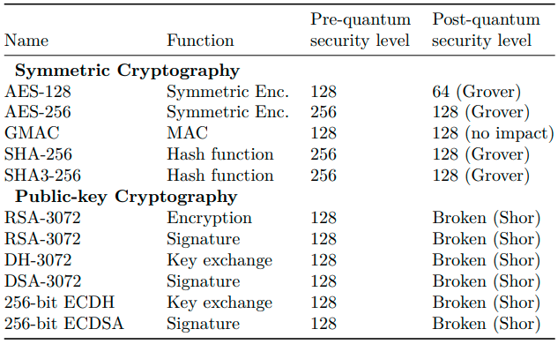
Shor’s algorithm impacts public-key cryptography only. However, the symmetric key cryptography is also affected by quantum computers, but through Grover’s algorithm. Here is a brief explanation of Grover’s algorithm .
GROVER’S ALGORITHM :
Grover's algorithm is a quantum algorithm that solves the unstructured search problem. In an unstructured search problem, we are given a set of N elements and we want to find a single marked element. A classical computer would need to search through all N elements in order to find the marked element, which would take time O(N). Grover’s algorithm, on the other hand, can find the marked element in time O(√ N).
Grover’s algorithm is a powerful tool that can be used to solve a variety of problems. For example, it can be used to find patterns in data, break cryptographic keys, and solve
optimization problems. As quantum computers become
more powerful, Grover’s algorithm will become
increasingly important.
This effectively halves the bit security of many symmetric
cryptographic algorithms .
Here the chart shows about the widely deployed
cryptographic systems and their conjectured post-quantum
security levels .

Slide 35

So as we already discussed before about what is lattice – based cryptography , how it works and how they can provide security in quantum computer and why lattice – based cryptography is one of the most sufficient method , So now we can proceed towards the algorithms of lattice – based cryptography . But before that we want to know you this, a lattice an abstract periodic structure, consisting of an infinite set of discrete points in n-dimensional Euclidean space . Ajtai has proved that certain NP-hard lattice problems are, in the average-case, as hard to solve as in the worst-case. This proof paved the way for adopting lattice-based schemes in cryptography.
NOTATIONS :
There are some notations which we should know to understand the algorithms .
Zq : It indicates the ring of integers modulo . Where q is a positive integer .
Rq : It means the quotient ring obtained by modding out Zq[ X ] by the ideal generated by (X ^ n + 1).
Zq[ X ] : Ring of polynomials with coefficients in Zq .
(X ^ n + 1) : A polynomial statement .
k : Rank of module ( the rank increases for higher security level ) .
χ(S) : Represents a probability distribution where s indicates set from which the sampling occurs .
x : Variable that will take value sampled from χ(S) .
x ← χ(S; r) : r represents seed. Seed is typically a parameter that initializes the RNG used for sampling .
U : It represents uniform distribution .
r ← U( {0, 1} ^ 256) : It means r is followed by any combination of 0 and 1 of 256 length .
βμ : Represents binomial distribution with parameter μ . Where μ is even positive integer .
( binomial distribution means a discrete probability distribution of the no of successes in
sequence of n , where n is independent elements ) .

Slide 36

So now we are ready to understand the algorithms . Here we are going to break down two algorithms ( i ) SABER and ( ii ) CRYSTAL – KYBER . But before breaking down the algorithms we will see little things about SABER and CRYSTAL – KYBER . So let’s start with SABER .
SABER :
Saber [14] is an IND-CCA2 secure KEM ( Key Encapsulation Mechanism ) . It is based on an IND-Chosen Plaintext Attack (CPA) secure PKE ( Public Key Encryption ) scheme, Saber.PKE. Indistinguishability under CPA, IND-CPA, means that one cannot distinguish two ciphertexts based on the messages they encrypt. This property is a basic requirement of most provably secure PKE schemes. An IND-Chosen Ciphertext Attack (CCA) secure KEM, Saber.KEM, is constructed from Saber.PKE through a version of the Fujisaki-Okamoto (FO) transform.
Saber.PKE consists of three parts:
( i ) Key Generation ( Saber.PKE.KeyGen () )
( ii ) Encryption ( Saber.PKE.Enc () )
( iii ) Decryption ( Saber.PKE.Dec () )
Saber.KEM also consists of three parts:
( i ) Key Generation ( Saber.KEM.KeyGen () )
( ii ) Encapsulation ( Saber.KEM.Encaps () )
( iii ) Decapsulation ( Saber.KEM.Decaps () )

Slide 37

Saber.PKE :
Key Generation :
function Saber.PKE.KeyGen() [ using function ]
uniform distribution of 0 and 1 where length is 256
seedA ← U({0, 1} ^ 256)
using a random variable which can be used as seed also
pseudorandom matrix
A = gen(seedA) ∈ Rq (k x k) security level
quotient ring
r ← U({0, 1} ^ 256)
using another random variable which can also be used as seed to store the bits
s ← βμ( Rq ( k×1 ) ; r)
used to store the matrix
binomial distribution with parameter μ ( even positive int )
b = ((A ^ T . s + h) mod q) >> (Ɛq − Ɛp) ∈ Rq ( k×1 ) [ A ^ T = Transpose of matrix A ]
resulting matrix
constant vector
return (pk = (seedA, b), sk = s) [ pk = private key and sk = secret key ]
end function

Slide 38

Saber.PKE :
Encryption :
function Saber.PKE.Enc((seedA, b), m; r)
A = gen(seedA) ∈ Rq (k x k)
if r is not specified
then r ← U({0, 1}256)
end if
s’ ← βμ( Rq ( k×1 ) ; r)
u = ((A . s’+ h) mod q) >> (Ɛq − Ɛp) ∈ Rq (k x k)
v’ = b ^ T (s mod p) ∈ Rp
v = ((v+ h1 − 2 ^ (Ɛp−1)m) mod p) >> (Ɛp − ƐT ) ∈ RT return (c = (u, v))
end function
Here b ^ T = Transpose of matrix b ;
h1 = constant polynomial ;
m = plaintext message which we want to encrypt ;
>> = represents bitwise right shift operator ;
Decryption :
function Saber.PKE.Dec (s,(u, v) )
v’ = u ^ T (s mod p) ∈ Rp
m’ = ((v’+ h2 −2 ^ (Ɛp − ƐT ). v)mod p) >> (Ɛp − 1) ∈ R2 return m’
end function
Here u ^ T = Transpose of matrix u ;
h2 = constant polynomial
m’ = plaintext message which we want to decrypt ;
>> = bitwise right shift operator ;

Slide 39
Saber.KEM :
Saber.KEM is basically constructed from Saber.PKE through a version of the Fujisaki - Okamoto transform . It is a technique to convert a chosen plaintext secure public key encryption scheme into a chosen ciphertext secure scheme in order to increase the security level .
Key Generation :
function Saber.KEM.KeyGen()
(seedA, b, s) = Saber.PKE.KeyGen()
pk = (seedA, b)
pkh = F(pk)
z ← U({0, 1} ^ 256)
return (pk = (seedA, b), sk = (z, pkh, pk, s))
end function
Here, pk = public key ;
sk = secret key ;
z = variable, can be used as seed also
F = F is a hash function
Encapsulation :
function Saber.KEM.Encaps ((seedA, b))
m ← U({0, 1} ^ 256)
(K ^ , r ) = G (m, F(pk))
c = Saber.PKE.Enc ( pk, m; r)
K = H (H(c), Kˆ )
return (c, K)
end function
Here m = ciphertext message which we want to encrypt ;
c = ciphertext ;
K^ = derived key ;
K = shared secret key ;
H = hash function of SHA3 - 256 ;
G = hash function of SHA3 – 512 ;
Decapsulation :
function Saber.KEM.Decaps((z, pkh, pk, s),c))
m’ = Saber.PKE.Dec(s, c)
(Kˆ, r’ ) = G (m’, pkh)
c’ = Saber.PKE.Enc (pk, m ; r )
if c’ = c then
return K = H (Kˆ, c)
else
return K = H (z, c)
end if
end function
Here m’ = ciphertext message which we want to decrypt ;

Slide 40
CRYSTAL – KYBER :
CRYSTALS-Kyber is also an IND-CCA2-secure KEM. Similarly to Saber, it contains an IND-CPA secure encryption scheme, Kyber.PKE, and an IND-CCA secure KEM ( Key Encapsulation Mechanism ), Kyber.KEM , which is obtained from Kyber.PKE through a version of the FO ( Fujisaki Okamoto ) transform. There are three versions of CRYSTALS-Kyber, Kyber512, Kyber768 and Kyber1024, for k = 2, 3 and 4, respectively .
The Decode function decodes an array of 32l bytes into a polynomial with n coefficients in the range {0, 1, ··· , 2^l − 1}. The Encode function is the inverse of Decode. It first computes each polynomial coefficient individually and then concatenates the output byte arrays .
The Compressq (x, d) and Decompressq (x, d) functions are defined by:
Compressq (x, d) = [(2^ d/q) · x]mod ⁺ 2 ^ d
Decompressq (x, d) = [(q/2 ^ d) · x]
Kyber.PKE consists of three parts:
( i ) Key Generation ( Kyber.PKE.KeyGen () )
( ii ) Encryption ( Kyber.PKE.Enc () )
( iii ) Decryption ( Kyber.PKE.Dec () )
Kyber.KEM also consists of three parts:
( i ) Key Generation ( Kyber.KEM.KeyGen () )
( ii ) Encapsulation ( Kyber.KEM.Encaps () )
( iii ) Decapsulation ( Kyber.KEM.Decaps () )

Slide 41

Kyber.PKE :
Key Generation :
function Kyber.PKE.KeyGen()
(ρ, σ) ← U({0, 1}256)
A ← U( Rq (k x k) ; ρ)
s, e ← βη1 ( Rq (k x 1) ; σ)
t = Encode12(As + e)
s = Encode12(s)
return (pk . = (t, ρ), sk . = s)
end function
Here ρ, σ = random parameters , can be used as seed also
A → generate a matrix
s = secret key
e = error term
t = resultant matrix
Encode12 → function that encodes a matrix into a byte string .
pk = public key
Encryption :
function Kyber.PKE.Enc (pk = (t, ρ), m, r)
t = Decode12(t)
A ← U( Rq (k x k) ; ρ)
r ← βη1 ( Rq (k x 1) ; r)
e1 ← βη2 ( Rq (k x 1) ; r)
e2 ← βη2 ( Rq (k x 1) ; r)
u = A ^ T r + e1
v = t ^ T r + e2 + Decompressq(m, 1)
u = Encodedu (Compressq(u, du)
v = Encodedv (Compressq(v, dv)
return c . = (u, v)
end function
Here r = random variable to store matrix
e1 and e2 = error term
A ^ T = transpose of matrix A
t ^ T = transpose of matrix t
u and v = resultant matrix
βη = binomial distribution
Decryption :
function Kyber.PKE.Dec(s, c = (u, v)))
u = Decompressq ( Decodedu (u), du)
v = Decompressq ( Decodedv (v), dv)
s = Decode12(s)
m’=Encode1(Compressq(v − s · u,1)) return m’
end function
Here m’ = message which you want to decrypt
Decode12 = function that decodes a byte string into a polynomial representation.

Slide 42
Kyber.KEM :
Kyber.KEM is basically constructed from Kyber.PKE through a version of the Fujisaki - Okamoto transform . As we mention about it before , it is a technique to convert a chosen plaintext secure public key encryption scheme into a chosen ciphertext secure scheme in order to increase the security level .
Key Generation :
function Kyber.KEM.KeyGen()
z ← U({0, 1} ^ 256)
(pk,s)= Kyber.PKE.KeyGen()
sk . = (s, pk, H(pk), z)
return (pk, sk)
end function
Here, z = random variable , can be used as seed also
pk = public key
sk = secret key
H = hash function of SHA3 – 256
Encapsulation :
function Kyber.KEM.Encap(pk)
m ← U({0, 1} ^ 256)
(K ^ , r ) = G(m, H(pk))
c= Kyber.PKE.Enc(pk, m ; r)
K = KDF(K ^ , H(c))
return (c, K)
end function
Here , m = message which we want to encrypt
KDF () = key derivation function
c = ciphertext
G = hash function of SHA3 – 512
K ^ = derived key
K = shared secret key
Decapsulation :
function Kyber.KEM.Decaps (sk , c)
m’ = Kyber.PKE.Dec (s, c)
(Kˆ ‘ , r ‘) = G(m’ , H(pk))
c’ = Kyber.PKE.Enc(pk, m’; r ‘)
if c = c ‘
then return K = KDF(K ^ ,H(c))
else
return K = KDF(z, H(c))
end if
end function
Here , m’ = message which we want to decrypt
c’ = new ciphertext

Slide 43
POWER ANALYSIS OF MASKED SOFTWARE IMPLEMENTATION ( 3 )
To know about this chapter we need to know about “ Deep Learning “ .
Deep Learning
Subfield of Machine Learning
inspired by the structure and function of the brain, specifically the NNs that make up the brain
Involves training artificial NNs on large dataset for the network to make own decision.
It consists multiple layers of artificial NNs, which are trained using backpropagation method, the algorithm is fed a large dataset and makes predictions based on that data, compares its predictions to the correct output, until the error is minimized.

Slide 44
In this chapter
Profiled side channel attacks on first and higher order masked software implementation and crystal-kyber algorithm using deep learning based power analysis.
Single step message recovery capable of recovering messages from a first-order masked implementation directly, without explicitly extracting the random masks.
Then comes recursive learning, it extends single step method to higher order masked implementations.
New error correcting code(ECC) based secret key recovery method using chosen ciphertexts. It is used to extract secret key even if there are some errors in messages, recovered from chosen ciphertexts.

Slide 45
PREVIOUS WORK
Saber and CRYSTALS-Kyber algorithms are closely related and so many authors describe attacks which are portable from one to the other.
It shows implementation-level vulnerability in the message decoding operation of LWE/LWR algorithms,such as NewHope, Saber, Kyber, LAC .
The authors demonstrated a message recovery attack using templates constructed from power traces collected during the execution of the vulnerable code.
the authors pointed out that the identified vulnerabilities in the FO transform could be applicable to other candidates such as Kyber, Frodo, Saber which continued
The authors demonstrated a successful secret key recover using several thousand EM traces(used for extracting sensitive info.) captured from the ECC and FO transform leakage points.
The masking schemes were suggested by the authors a means of protecting the decryption algorithms form side-channel attacks.
message recovery attack (session key recovery) using a single trace on the unprotected encapsulation, where secret key recovery in 184 traces for 98% success rate.
Primas et al.(scientist) presented the first single-trace attack on a masked implementation of the RLWE PKE scheme, it uses NTT to retrieve each share separately, and then recombine the shares to recover the masked secret.
Discrete Fourier Transform (DFT) that is often employed as fast multiplication algorithm for compatible rings.It performs 61% faster multiplication and an overall 22% reduction in encapsulation cycles.
Saber is the only lattice based algorithm which doesn't use NTT(Number-Theoretic Transform) related leakage point.

Slide 46
ATTACK SENARIO
MESSAGR RECOVERY ATTACK
Enemy has physical access to the decapsulation device to acquire side channel information, can eavesdrop on the ciphertext c that is being decrypted/decapsulated.
SECRET KEY RECOVERY ATTACK
Here enemy has ability to query the device with chosen ciphertexts. Where, query the device means the enemy/adversary sending these chosen ciphertexts to decrypt and receiving plaintext back.
LWE/LRW :
Learning with error problem becoming more and more used in cryptography. It is used to find best algorithm that can solve problem having concrete parameter, improves speed up(by eliminating small errors from a gaussian like distribution with deterministic errors) and bandwidth.

Slide 47
Attack Method
It demonstrate to recover both the session key and the long-term secret key from a small number of traces, we describe the new single-step message recovery approach and show that it is applicable not only to the first-order masking but also extends to higher orders, also ECC based secret key recovery approach.
MESSAGE RECOVERY
1. PREVIOUS METHOD:PROFILING STAGE
Leakage profile learning from target implementations either by constructing templates or training NN models, power/EM traces from a profiling device in which masking countermeasures is deactivated, or values of the share are known.
Bit-wise leakage is targeted, in this the profiling aims to distinguish between cases when msg bit value '0' is processed at the point of interest from a case, when the msg bit takes the value of 1(When masking is deactivated and NN models are used to learn leakage profile).

Slide 48
2. PREVIOUS METHOD : ATTACK STAGE
In order to deactivate the countermeasure(used to prevent undesirable outcome of process) or fix the mask, one requires the implementation source code of the algorithm under attack.
At the attack stage, the previous methods used to create templates/NN models to recover all shares of the target masked target implementation one by one, and then combine them to recover the message.
Single Step Approach :
1 . NEW METHOD : PROFILING STAGE
This method leverages the advanced pattern recognizing ability of deep learning models.
In interference phase NN models shares bits rj and rj XOR mj (corresponding to given message mj).
XOR operation performs on the shares to compute message bits as mj=rj XOR (rj XOR mj).
Ability of NNs combine shares using XOR with a higher than 99% success probability was a new finding.
2 . NEW METHOD : ATTACK STAGE
Single step approach enables "profiling on traces captured from a device under attack(DUA)".(here knowledge of masking not necessary)
It helps maximization NNs classification accuracy, enables repetition attacks as there is no need explicitly recover the random mask with single trace.
single-step method to the higher-order implementations of Saber, it extends directly to the second- and third-order masked implementations.
To help NN we introduce new training method called recursive learning.

Slide 49
Recursive Learning
It starts training from an artificially constructed NN. For an attack on an omega(ω)-order masked implementation.
N^(ω) is the starting network constructed by copying the weights of the input Batch Normalizer layer of a model N^(ω-1) trained on the (ω-1) order masked implementation.
Then it extends input Batch Normalizer layer of N^(ω) to include one more share, we help N^(ω) to locate trace segments corresponding to (ω+1) shares.
Experimental result shows for masking orders ω>4, the probability finding such a model without recursive learning is small.
Recursive Learning can look alike transfer learning, but recursive learning we do not only transfer a model but also extends it, we construct the initial weight of larger NN based on weights of smaller NN(It is not same like transfer learning).

Slide 50
Cyclic Rotation
It increases success rate of the message recovery.
The leakage in the target implementation of crystal-kyber is uneven.
First bit of each msg byte leak much stronger than the last one.
We cyclically rotate the message to shift its bits from "less leaky" positions to "more leaky" and then extract them from there.
Rotation happens by manipulating the corresponding ciphertexts.
Session-key Recovery
Given ciphertext c, the session key K can be obtained by recovering the message m contained in c and then computing
(Kˆ', r') =G(m, H(pk)) and K = KDF(Kˆ', c)
(here, Kˆ'=session key vector representation, r'=seed(a parameter that initializes RNG used for data sampling),G&H=hash function, m=plaintext message, KDF=key derivation function, c=ciphertext)

Slide 51
Secret Key
About this approach we discussed in the previous chapter here we will discuss about its message bit probability. S-key can be recovered with 12 queries assuming perfect message bit recovery, but recovering all message bits with 100% probability is very difficult in practice.
Average empirical probability of message bit recovery is 99.7%. Single 256-bit message correctly is 0.997256 = 46.34%. Probability of recovering all 12 messages correctly is 0.463412 = 9.8 × 10−5.
ECC based approach
Error correcting code based chosen ciphertexts construction method.
Secret key coefficients are mapped into codewords composed from the message bits.
The mapping for Saber algorithm shown extended hamming code can correct single bit error and detect two errors in each secret key coefficient.
The presented ECC based approach is general and can be extended to other ECCs and other LWE/LWR algorithms.

Slide 52
Exploit Vulnerabilities :
The attack on the first-order masked Saber exploits two leakage points during message decoding. The first one is in the primitive for masked logical shifting on arithmetic shares poly_A2A().Here leakage is bitwise and identical.
Second leakage point POL2MSG(),packs decoded msg bits into byte array in memory, here leakage different for different bit positions within a byte.
The bit which is packed first leaks much stronger than the bit which is packed last. This type of leakage is known as Incremental-Storage Vulnerability (results incremental update of the same memory location during bit/byte packing operations).
Higher-order masked Saber exploits (make use of) a leakage point during the message decoding, the primitive A2B_bitsliced_msg().
Leakage of poly_A2A() and A2B_bitsliced_msg() is bitwise identical(except corner cases),the difference between them is A2B_bitsliced_msg() is executed in eight 32 bit iterations, end of each iteration when arithmetic to boolean conversion of shares is completed, the shares are copied from intermediate variable into the message structure, one bit at a time. This is called location of vulnerability(the state of being harmed).

Slide 53
Algorithm : Message Encoding from CRYSTALS-Kyber :
function poly_frommsg(poly *r, unsigned char msg[32]) uint16 mask
for (int i=1; i < 32; i++) do
for (int j=0; i < 8; j++) do
mask = -((msg[i] >> j) &) 1 )
r.coeff[8*i+j] = mask & ((KYBER_Q + 1)/2)
end for
end for
end function
Algorithm mask value has only two states 0*0000 or 0*FFFF, since difference of hamming weight between the states is equal to 16,it can be easily distinguished from power traces, this is called Determined Leakage Vulnerability.
Here, poly_frommsg=function name, poly *r=a pointer to poly object, unsigned char msg[32]=an array 32 unsigned characters representing a message, uint16 mask=unsigned 16bit integer variable, mask = -((msg[i] >> j) &) 1 ) = this creates a mask where all bits are set to 1 except for j-th bit , which is set to 0 based on value corresponding bit msg[i], r.coeff[8*i+j] = mask & ((KYBER_Q + 1)/2) = sets coeff in the polynomial to either 0 or a specific value based on the bit value in the msg and the constant Kyber_Q.

Slide 54
Higher order masked crystal-kyber exploits a leakage point during the msg encoding performed when re-encryption step happening for decapsulation.
In higher order masked Crystal-kyber the leakage is different for different bit positions within a byte.
Experimental Results :
From Paper-I we get to know message recovery attacks and secret key recovery attacks ECC-based chosen ciphertext construction method was essential for improving the success rate of secret key recovery.
The average empirical probability of message bit recovery is 99.7%,256-bit message correctly is 0.997256 = 46.34%.
From Paper-VI we get to know the MLPs trained for the experiments show that the average empirical probability of message bit recovery decreases with the growth of the number of shares, this is not surprising since the difficulty of the problem grows. By repeating the measurements more than once, we are still able to recover a full secret key from both DUA and a different device.
From Paper-VI we get to know through the use of our recursive learning training method combined with cyclic rotations, we successfully recovered messages from up to the fifth-order masked implementation of CRYSTALS-Kyber.
As with the higher-order Saber case, we observed a decrease in the average empirical probability of message bit recovery as the number of shares increased.
For the fifth masking order, we needed to repeat the measurements more than once to increase the success rate, with five repetitions, the probability of correctly recovering a full 256-bit message is 0.99946256 = 87%.

Slide 55
SUMMARY
The research presented in this chapter demonstrates that deep learning is a powerful tool for analyzing masked implementations of LWE/LWR PQC algorithms.
By recognizing significant features in traces and performing operations like XOR, deep learning enables a new class of side-channel attacks that were previously not found.

Slide 56
Power Analysis of Masked & Shuffled Software Implementations ( 4 )
From previous chapter we know for software implementations of Saber and CRYSTALS-Kyber algorithms, masking does not provide adequate protection from side-channel analysis.
In this chapter we are going to discuss about masking and shuffling both countermeasures.
We show deep learning based power analysis can break the combined countermeasures as well.
Here we discuss two message recovery approach
1)It depicts the HW(hamming-weight) of a message remains constant independently of the bit order. So, by bit flipping a bit and re-computing the HW we can get the value of a bit.
2)It attempts to determine the correct order of the message bits by recovering FY(Fisher-yates) indexes directly, during their generation.
Both successful in recovering messages, by recovering messages from chosen ciphertexts, we recover the secret keys of Saber and CRYSTALS-Kyber algorithms. Also, we extend the ECC-based chosen ciphertext construction method presented in the previous chapter to ECCs with larger code distances.

Slide 57
Previous Work :
Paper II is the first successful attempt to break a masked and shuffled implementation of a PQC algorithm.
These two countermeasures combined together were previously believed to provide adequate protection against side-channel attacks.
we reviewed the previous work on masked-only PQC and attack on shuffled-only PQC algorithm implementation.
Ravi et al. introduced an important technique called bit-flip which we use in the attacks.
Given a ciphertext c = (u, v), the bit-flip technique constructs 256 ciphertexts cj , j ∈ {0,..., 255}, in which the value of the center of the integer ring Zq is subtracted from the jth coefficient of v, the message polynomial is only additively hidden within a ciphertext, this results in a ciphertext cj decrypting to the message mj which is equal to the message m = Saber.PKE.Dec(s, c) with jth bit flipped.
It describes a method of creating multiple slightly altered versions of a ciphertext through bit-flipping, while maintaining the ability to recover the original message with a specific bit flipped. This technique can have applications in cryptography, particularly in scenarios where slight modifications to encrypted data need to be explored or analyzed.

Slide 58
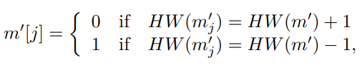
Bit-flip Technique: It begins by creating 256 modified versions of an encrypted message by subtly changing a specific part of it. These modifications are made by subtracting a value from a particular component of the encrypted data.
Side-Channel Attack: In this attack, traces (data points) are collected from the device that performs the decryption process. These traces include information about the original encrypted message and all its modified versions created using the bit-flip technique.
Side-Channel HW Classifier: A classifier is used to analyze these traces and determine certain characteristics of the decrypted messages, specifically their Hamming Weight (HW). The Hamming Weight essentially measures the number of 1s in a binary sequence.
Message Recovery: From the HW values obtained for each modified version of the decrypted message, a decision is made about the original message. If the HW value of a modified message differs from the HW value of the original message by just one, then it's considered a candidate for the original message. This process is repeated for all modified versions, and the most common candidate is chosen as the likely original message.
It outlines how an attacker can exploit side-channel information to get the content of an encrypted message by analyzing variations of its decryption process, focusing on the Hamming Weight of the decrypted data.

Slide 59
Attack Scenario :
The attack scenario for the message and secret key recovery attacks in this chapter is similar to the one, but it has one additional requirement.
We assume an adversary has a device capable of profiling, similar to the targeted device, and it is used to understand or exploit vulnerabilities in the target algorithm running on the targeted(attacked) device.
Attack Method :
we describe two different approaches for message recovery from masked and shuffled implementations of LWE/LWR PQC algorithms.
Then, we present an extended version of the ECC-based secret key recovery method presented in Paper I which uses ECCs with a larger code distance.

Slide 60
Message Recovery :
Hamming weight-based approach :
It combines the single-step message recovery method introduced in Paper I with the bit-flip technique of Ravi et al. To recover the message mj encrypted in a given ciphertext c, we apply the bit-flip technique to construct 256 bit-flipped versions of c, cj, and capture traces from the decapsulation device for c and cj, for each j ∈ {0,..., 255}.
Then, using the same profiling strategy as in the single-step method of Chapter 3, we train NNs capable of recovering the individual message bits from a masked implementation. At the attack stage, these NNs are used to determine HWs of m and mj, for each j ∈ {0,..., 255}. Finally, m is recovered using eq m'[j].
To increase the success probability additional technique introduced such as detection of potentially erroneous message bits and removal of outliers.(It's like checking if any parts of the decrypted message seem wrong or out of place, and then either fixing them or disregarding them when trying to understand the original message. This helps improve the accuracy and reliability of the decryption process, especially in scenarios where the encrypted data might be affected by noise or deliberate manipulation).

Slide 61
A technique worth mentioning in more details is spicing.
difference between the attacks on masked-only and masked and shuffled implementations is that when we use both masking and shuffling techniques, attackers face additional challenges because they can't rely on the traditional DUA method, which depends on knowing the order of bits. The shuffling of bits(where order of bits is unknown) complicates the profiling process, making it harder for attackers to exploit side-channel information effectively.
profiling on a different device typically deteriorates the classification accuracy of NN models due to device inter-variability(inter-variability refers to how much individuals or entities differ from each other within a given set of data or population).
To minimize the deterioration, we train on a combination of traces from the profiling device running an implementation with deactivated shuffling, and traces from the DUA captured for all-0 and all-1 messages, the labels of all bits are the same for all-0 and all-1 messages and therefore shuffling order doesn’t matter for labeling the training set.
we show that such a combined strategy helps us minimize the negative effect of device inter-variability on NN model’s classification accuracy.
It show that training on 100% of traces from the DUA captured for all-0 and all-1 messages is not the best choice because traces of all-0 and all-1 messages do not allow NNs to learn all possible features.

Slide 62
FY index-based approach :
Direct Recovery of FY Indexes :
Focus on recovering FY indexes during their generation.
Emphasis on FY indexes 0 and 255 as "corner" indexes.
Cyclic Rotation Technique:
Extract corresponding message bits from corner FY indexes.
Cyclically rotate the message via ciphertext modification.
Enables extraction of all message bits after 128 rotations.
Error-Free Rotation :
Technique ensures rotation without errors in wrapped-around bits.
Ciphertexts and chosen ciphertexts (CCTs) treated differently.
Neural Network (NN) Profiling :
NNs trained during profiling stage for message bit and FY index recovery.
Similar strategy as masked implementations but with adjusted layer width.
Same MLP architecture as in Paper II utilized for training.

Slide 63
Secret Key Recovery :
Iterative Chosen Ciphertext Construction :
Building on Past Work:
This approach expands on a method introduced earlier, building upon the foundation laid out in Paper I.
In essence, it's refining a technique used for constructing chosen ciphertexts.
Step-by-Step Improvement:
Instead of sticking to one fixed method, it iterates over different versions of the technique, each slightly improved over the last.
Each iteration aims to reduce the total time needed to capture the necessary chosen ciphertexts.
Construction Details :
Creating Ciphertexts:
To understand this, imagine creating 3 sets of ciphertexts (denoted by l) to extract secret key coefficients.
Each set contains 256 elements, representing different parts of the secret key.
These elements are derived from codewords, which are sequences of bits generated using a specific mathematical method called linear codes.
Message Recovery from Chosen Ciphertexts :
Decoding the Message:
Now, let's dive into how the actual message is extracted from these ciphertexts.
The process involves carefully examining the ciphertexts and decoding the bits to reconstruct the original message.
This decoding process is guided by predefined tables that map ciphertext components to message bits.
Selecting Constants:
Crucial to this process is the selection of constants (k0 , k1 , k2 ), which ensure that each secret key coefficient corresponds uniquely to a set of message bits.
Additionally, for CRYSTALS-Kyber, an extra constant (k2 ) is employed to manage the distribution of bits within a byte effectively, minimizing interference and maximizing recovery accuracy.
Furthermore, these constants are chosen to ensure that decryption behaves consistently across different implementations, even when one is masked to protect against attacks.
It aims to refine and improve the process of extracting secret information from encrypted data, ensuring both efficiency and accuracy while maintaining security against potential attacks.

Slide 64
Expected Vulnerabilities :
For the message bit recovery from Saber implementation, both HW-based and FY index-based methods exploit the vulnerability in the primitive for masked logical shifting on arithmetic shares poly A2A shuffled()
As in the attack on the masked-only implementation of Saber, the leakage is bit-wise and identical for all message bits.
For the message bit recovery from CRYSTALS-Kyber implementation, the message bits are accumulated into a byte array in memory during their processing by masked poly tomsg() procedure. As a result, within each byte, the bit accumulated first leaks stronger than the bit accumulated last. This makes message recovery more difficult.
To recover FY indexes, two locations are targeted: the point where FY indexes are generated and the point where they are used. The first one is a call to FY Gen() which creates a random permutation of 256 indexes. We use the same implementation of FY Gen() is used in Saber and CRYSTALS-Kyber algorithms.
The second blue one, the FY indexes are used to define the processing order of message bits in the for-loop. The side-channel leakage from both parts is used for FY index recovery. The first part leaks much stronger than the second.

Slide 65
Experimental Results :
Experiment Setup :
Implementation Basis:
Papers II and IX were performed using the C implementations which we built on top of the first-order masked implementation of Saber from and CRYSTALS-Kyber from, respectively
No publicly available implementations incorporating both masking and shuffling were found.
Hardware and Profiling:
Conducted experiments on two CW303 boards equipped with ARM Cortex-M4 microcontrollers.
One board used for profiling, and the other for testing.
Trained multiple Multilayer Perceptron (MLP) models on trace sets, varying proportions from the profiling device and DUA.
Profiling device ran implementation with deactivated shuffling.
Results and Analysis:
Error Identification and Resolution:
Identified potentially erroneous message bits, aiding in error detection and resolution.
Detected bit errors handled by enumerating possible choices, contributing to improved classification accuracy.
Spicing technique further enhances accuracy.
Ensemble Approach(a method in ML uses for building predictive models)s:
Reduced test traces required for attack using an ensemble of models.
Ensemble method known for efficiency in side-channel analysis.
Total number of traces for secret key recovery significantly reduced with ensemble method.

Slide 66
FY Index-Based Approach :
Profiling and Training:
Two types of NNs trained: one for FY index recovery and another for message bit recovery.
Similar training method as in HW-based case for message bits recovery.
FY index recovery NNs input concatenates intervals covering FY index generation and usage.
Key Recovery Attacks:
Conducted 10 secret key recovery attacks each on Saber and CRYSTALS-Kyber implementations, with varying code distances.
Utilized chosen ciphertexts based on ECCs with different code distances for each algorithm.
Key Recovery Results :
Beneficial Extensions:
Extending ECC-based approach to larger code distances proved advantageous.
Significant improvements in secret key recovery demonstrated, notably for Saber.
Analysis of Results:
ECC with code distance 6 yielded notable improvements, allowing for faster and more efficient key recovery.
Higher number of attack traces required for CRYSTALS-Kyber attributed to non-uniform leakage of masked message bits and lower sampling rate.

Slide 67
SUMMARY :
We demonstrated two different message recovery attacks on first-order masked and shuffled implementations of Saber and CRYSTALS-Kyber by deep learning-based power analysis. Both attacks are successful in recovering messages.
In addition, we extended the ECC-based chosen ciphertext construction method introduced in Paper I to ECCs with larger code distances.

Slide 68
AMPLITUDE MODULATED EM BASED SIDE CHANNEL ANALYSIS ( 5, 6 )
Side-channel attacks based on amplitude-modulated EM emanations are more stealthy than power or near-field EM attacks because the signal transmitted by the on-chip antenna escapes hardware-level countermeasures like decoupling capacitors and Faraday shields. Furthermore, since amplitude - modulated EM emanations are intertwined into the carrier signal, they can be captured at a considerably farther distance than the near-field EM side channels.
They show that utilizing information leaked through amplitude-modulated electromagnetic (EM) side channels, they can train NN that have a 90% probability on average of successfully recovering each bit of Saber’s message. However, it should be noted that even though individual bits of the message can be recovered with a high probability, this may not lead to a full message recovery.
To improve the success rate we introduce a multi-bit error-injection method which, in it is essence, converts a non -differential attack into a differential one. This allows us to exploit byte-level leakage and successfully recover full secret keys from both Saber and CRYSTALS - Kyber.

Slide 69
OBSERVATIONS :
This first attack, called screaming channels, was demonstrated by Camurati et al. The authors observed that mixed-signal chips integrating Bluetooth and Wi-Fi on board can inadvertently broadcast side-channel information about the data processed in the digital core. Due to various coupling effects, signals from computations in the digital core may leak to the analog part of the chip, become modulated by the radio -frequency block, and eventually transmitted by the antenna. The authors showed that it is possible to extract the amplitude-modulated EM emissions from the carrier signal and recover the key from a software implementation of AES-128 run by the digital core of nRF52832 device using a template attack based on traces captured from a distance of up to 10 meters to DUA in an anechoic chamber .
This result is improved , where the AES-128 key is recovered from 5K traces captured at 15 meters distance to the DUA in an office environment using 1K repetitions of the same encryption and key enumeration up to 223. The authors also highlight the broader security implications of the screaming channels.
MESSAGE RECOVERY METHOD :
Direct bit-wise message recovery :
In the direct bit-wise message recovery method, we train an individual NN model Ni for each message bit i, i ∈ {0, 1,..., 255}. The model N(i) is trained on the trace segments in which the bit i is processed, labeled by the value of the bit i. The segments are identified using t-test .

Slide 70
The model N (i) outputs a score vector Si , j = Ni ( Tj ) in which the value of the lth element, Si , j [1] is the probability that the ith message bit has value l ∈ {0, 1} in the trace Tj .
Multi - bit error injection :
we introduced a method called multi-bit error injection intended to handle byte-wise leakage . Let m = (m[0], m[1],...,m[31]) be a message to be recovered, where m[i] is the ith message byte, and c = (u, v) be a properly generated ciphertext encrypting m. We create 255 modified versions of c, denoted by c (e), which decrypt to
m (e) = (m[0] ⊕ e, m[1] ⊕ e, . . . , m[31] ⊕ e),
where e ∈ {1, 2,..., 255} is the injected error. The same error is injected into all message bytes in parallel. The original ciphertext c corresponds to the error-free case, c = c (0) . The modified ciphertexts c (e) are created by changing the coefficients of u so that, for every message byte i ∈ {0, 1,..., 31}, all bits of m[i] in which the 8-bit binary expansion of e has the value 1 are flipped. The bit-flip technique is used to flip a single message bit.

Slide 71
Exploited Vulnerabilities :
In the unprotected implementation of Saber from the NIST PQC webpage which is analysed . There are two known vulnerabilities : ----
The first is in the message decoding operation line 8 of indcpa - kem dec() , where the message bits are computed and stored in memory in an unpacked fashion.
The second is in the POL2MSG() procedure line 4 of POL2MSG() , where the message bits are packed into a byte array in memory .
RESULTS :
We first investigated the impacts of limited sampling rates. The core clock frequency operates at a f (clock) = 64MHz, while we used sampling frequencies, 5MHz, 12.5MHz and 25MHz, the latter is the maximum sampling frequency of USRP N210 SDR (limited by interface).
The SDR is used for amplitude-modulated EM analysis of a AES-128 implementation on the same target device and sampling at 5MHz was sufficient to successfully recover the key. We analysed whether a 5MHz sampling rate is sufficient for Saber KEM and also considered 12.5MHz and 25MHz sampling rates. The results in Table 2 of Paper IV show that the sampling rate of 25MHz gives the best results.

Slide 72
Additionally, we analyzed the impact of compiler optimization level on side-channel leakage. We compared no optimization (-O0) and the highest gcc optimization level (-O3) cases. We trained a NN model for each case and then tested them by recovering messages from 20 traces captured for the same ciphertext and applying the bit-wise majority voting on the predicted bits. The results for the first eight message bits. For the case without optimization, the average accuracy for the first eight bits is 85.1%. One of the bits, bit 7, is predicted with 100% accuracy. For the highest optimization level, the average accuracy drops to 74.5%. None of the bits is predicted with a higher than 90% accuracy.
It is clear that the direct bit-wise message recovery method cannot recover full messages without further improvements. The multi-bit error-injection method allowed us to exploit byte-level leakage more efficiently and increase the success rate of each byte recovery to the level where a full message recovery became possible.
SUMMARY :
In this section, we presented two deep learning-based side-channel attacks on unprotected software implementations of Saber and CRYSTALS-Kyber algorithms using amplitude-modulated EM emanations. The second attack can recover full messages of Saber and CRYSTALS-Kyber. The success is mainly due to the new multi-bit error injection method which can exploit byte-wise leakage.

Slide 73
Power Analysis of TRNGs ( 7 )
Secure systems, such as those used in banking, communications, and government, rely on random numbers with strong statistical properties.
Random numbers play critical roles in cryptographic protocols, including key generation, authentication, and data encryption.
Compromised or poorly designed random number generators (RNGs) can introduce vulnerabilities in cryptographic systems, potentially leading to unauthorized access or data breaches.
This chapter focuses on analyzing the power consumption of True Random Number Generators (TRNGs) and it is possible to train a NN model capable of recovering the HW of these random numbers from power traces with a higher than 60% probability.

Slide 74
PREVIOUS WORK :
Previous attacks on RNGs have primarily focused on introducing biases into generated random numbers through fault attacks.
Examples of fault attacks include injecting frequencies into the power supply, manipulating voltage or clock frequency, and applying ionizing radiation.
Some commercial products have been vulnerable to fault attacks, highlighting the importance of robust testing and protection mechanisms.
EM analysis has been utilized to gather information about RNG internals, such as the position and frequency range of ring oscillators.
Another attack vector involves inserting hardware Trojans to compromise RNG integrity. An alternative attack vector is inserting a hardware Trojan into an RNG to reduce the minimal entropy of random numbers.
Contrasting with previous work, this chapter focuses on passive side-channel attacks using power analysis techniques.

Slide 75
RNG Design and Security Assurance
Cryptographically secure RNGs typically consists a True Random Number Generator (TRNG which collects entropy from the physical world) and a Pseudo-Random Number Generator (PRNG which expands the seed from the TRNG into a longer sequence and performs additional post-processing).
The level of security of an RNG is typically quantified in terms of the size of random numbers it generates, based on the assumption that the RNG’s implementation is a “black-box” whose internal signals can neither be observed nor interfered with by an adversary.
The STM32 MCU RNG utilizes multiple ring oscillators whose outputs are XORed to generate a seed, followed by post-processing with a Linear Feedback Shift Register (LFSR).
When a sufficient number of seeds are accumulated into the LFSR, their content is transferred to a 32-bit data register. Two consecutive random numbers can be generated in 40 RNG clock cycles .
The design complies with security standards such as FIPS 140-2, BSI AIS-31, and NIST SP 800-90B to ensure cryptographic robustness(strong).

Slide 76
Attack Scenario :
The attacker aims to exploit the RNG to access other sensitive data stored or processed by the device under attack.
Assumptions include the presence of tamper response(unauthorized access) mechanisms but lack of specific protection against power analysis.
The attacker possesses expertise in side-channel attacks, deep learning, and has physical access to the target device.
Profiling is conducted using a similar device to gather data for analysis and model training, adversary also knows all critical security parameters which are stored on, or processed by, the device.
Attack Method :
To find whether the RNG integrated into the STM32F4 MCUs leaks exploitable side-channel information, we applied CPA to 1M power traces captured from the profiling device during the execution of the RNG.
We used the HW of the 32-bit random numbers generated by the RNG as a power model. We found that there is a strong correlation between the total power consumption of the device and the HW of random numbers.
To check if there is a bit-level leakage (which is easiest to exploit), we also performed a t-test for individual bits of random numbers, it indicates that the bits are perfectly aligned along the x-axis, implying that all bits are processed in parallel at the main leakage points. Due to the parallel processing, it is difficult to distinguish among individual bits of a 32-bit word.

Slide 77
To further analysis the leakage, we considered the distributions of power consumption for random numbers with different HWs, the results for the numbers with HWs 15, 16 and 17 at the point of strongest leakage, 234. We can see that the plots of different HWs do not overlap completely, implying that some cases should be possible to distinguish.
Based on the leakage assessment results, we concluded NN models which can recover the HW of 32-bit random numbers from power traces captured during the RNG execution.
Second contribution is a new method for mitigating device inter-variability based on iterative re-training.
The core idea is to first train a model on traces from the profiling device(s), and then re-train it iteratively by adding to the training set some traces from the device under attack labelled using the HWs predicted by the model trained from the previous iterations.
This simple strategy can considerably improve classification accuracy, it is important to carefully select the number of traces from the DUA which is added to the training set during re-training. If this number is too large, the NNs tend to get stuck to the wrong labels and the accuracy does not improve.

Slide 78
Experimental Results :
Having complete control over the profiling device, we can load the processor with code which is identical to the device under attack but modified to output the random numbers generated by the RNG in order to get labels for training. This type of modification can be done without significantly changing the features of power traces.
One cannot upload the modified code to the DUA since that would cause the erase sensitive info of all secrets in response to tamper detection(identify if a system or application has been modified in an unauthorized manner).
Using the iterative re-training method, firstly trained MLPs with the architecture on 1M traces captured from the profiling device, the resulting model M^0 was used to classify 1K traces from each DUA.
Next, for each DUA, we re-trained five times by adding 1K traces captured from the DUA and labelled by the HW predicted by the model from the previous iteration to the original 1M training set.
The iterative re-training helps raise the prediction accuracy by about 30%. However, for other devices, the improvement is less than 10%, it shows that the iterative re-training approach is especially effective for devices that are dissimilar to the one used for profiling.
The profiling devices and DUAs for which the improvement is large are newly acquired for this experiment, while DUAs with a small improvement are either older, or packaged in a different factory than the profiling device.
We also compared iterative re-training to the multiple devices approach by repeating the experiment using a 1M training set composed of traces from three devices.

Slide 79
Comparison with multiple devices approach shows superiority of iterative re-training, especially for diverse devices, However, for DUA different from the profiling devices, the results were significantly worse.
It is unlikely that the attacker knows the edge and worn-out conditions of the DUA, the iterative re-training approach seems to give the attacker an advantage .
Summary:
We show that it is possible to train a NN which can recover the HW of random numbers generated by the RNG integrated in STM32 MCUs from power traces.
The presented attack is the first passive side-channel attack on a hardware RNG embedded in a commercial integrated circuit.
The presented iterative re-training algorithm is not specific to RNGs and can be used in the side-channel analysis of other cryptographic algorithms.

Slide 80
Conclusion :
Objective of this thesis was to explore the impact that deep learning-based side-channel attacks have on the implementations of lattice based PQC algorithms.
Deep Learning Attacks on Masked Implementations(chapter 3)
Deep learning can bypass masking countermeasures
Higher-order masking offers limited protection
Complexity of attacks grows linearly with number of shares
Deep Learning Attacks on Shuffled Implementations(chapter 4)
Deep learning can recover messages from shuffled implementations
FY index-based method is more efficient than HW-based method
Deep Learning Attacks on Hardware Implementations(chapter 5,6)
Deep learning can attack hardware implementations of LWE/LWR PQC algorithms
Sliced multi-bit error injection method is effective for hardware attacks
Deep Learning Attacks on Random Number Generators
Deep learning can recover the Hamming weight of random numbers
This reduces the complexity of brute-force attacks
From various chapters we are getting more than one conclusion but if we combine them all it says
Deep learning poses a significant threat to the security of lattice-based PQC algorithms
Traditional countermeasures are not sufficient to protect against deep learning attacks
New security measures are needed to protect against deep learning-based side-channel attacks.

Slide 81
FUTURE WORK
This thesis reveal that traditional masking and shuffling countermeasures may be inadequate in sufficiently protecting software implementations against side-channel attacks. However, masking can be an effective technique for protecting hardware implementations, shares are processed in parallel and synchronization is ensured.
To enhance the protection of software implementations, a possible approach is to increase the attack difficulty by accumulating multiple bits of a sensitive variable into a register before writing them in memory, the more bits that are accumulated, the more challenging it becomes to extract the sensitive variable.
Although, accumulating a single byte may not provide sufficient protection since a multiple-bit error injection method could potentially extract the bytes.
A good rule of thumb is to choose an accumulation size n that is too large for a good 2n-class neural network model to be trained. It is also worth noting that the bound on the required size of n is likely to increase with further advances in deep learning, similar to how the secret key size increases as attacks become more sophisticated.

